Slide 1
HEAVEN IS A WASTE PLACE

Slide 2
The Ongoing Now
Corporate Mythology
Ephemera, Objects
Logo, Branding, Slogans
Simulation
Real Workshop
Office Role Play
Mission, Mythos, Objectives
Fake Onboarding Meeting
Procedurally Generated Personalities

Slide 3

Open Positions for Waste Research Team
Waste Drone
Impact Analyst
Process Analyst
Associate

Slide 5
The End Of The World
Notes:
Our business model

Slide 6
Upcycling the Apocalypse
Notes:
It

Slide 7
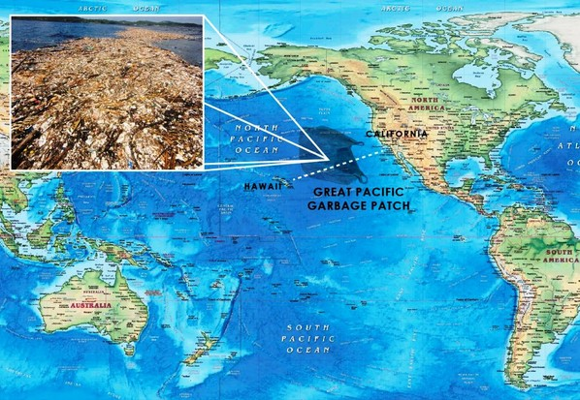
Great Pacific Garbage Patch
Exciting Opportunity?
Ecological Disaster?

Slide 8
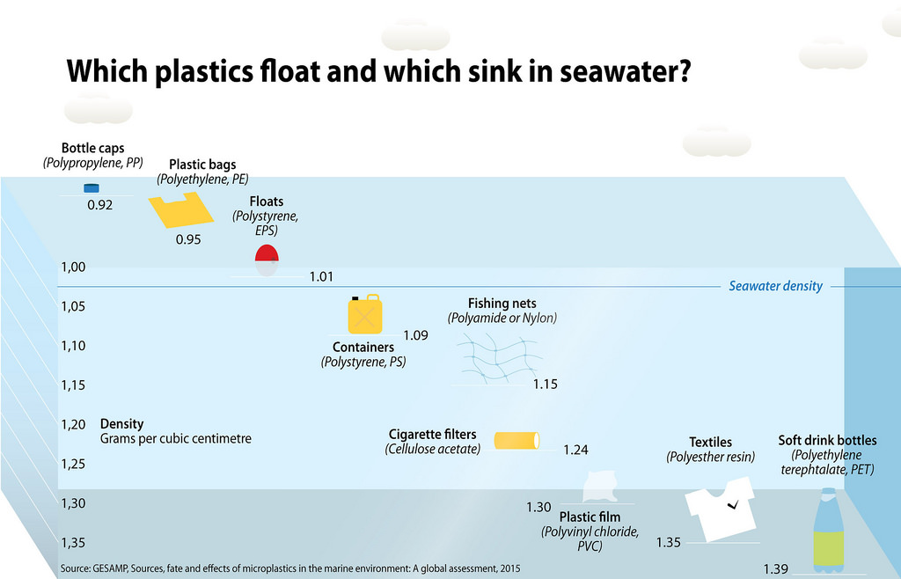
Our Research

Slide 9
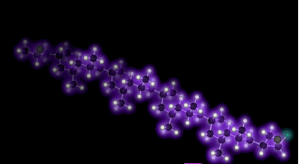
Polypropylene

Slide 10
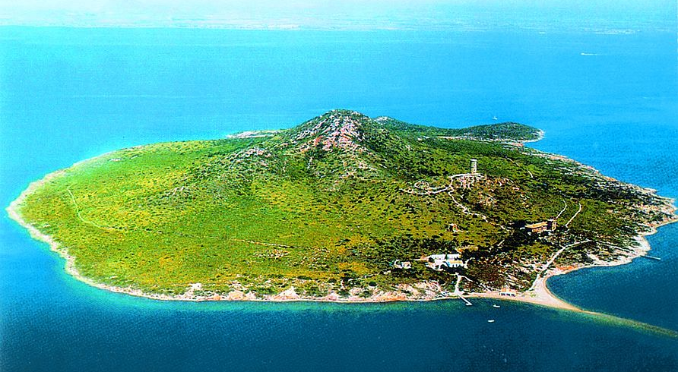
Artificial Garbage Island

Slide 11
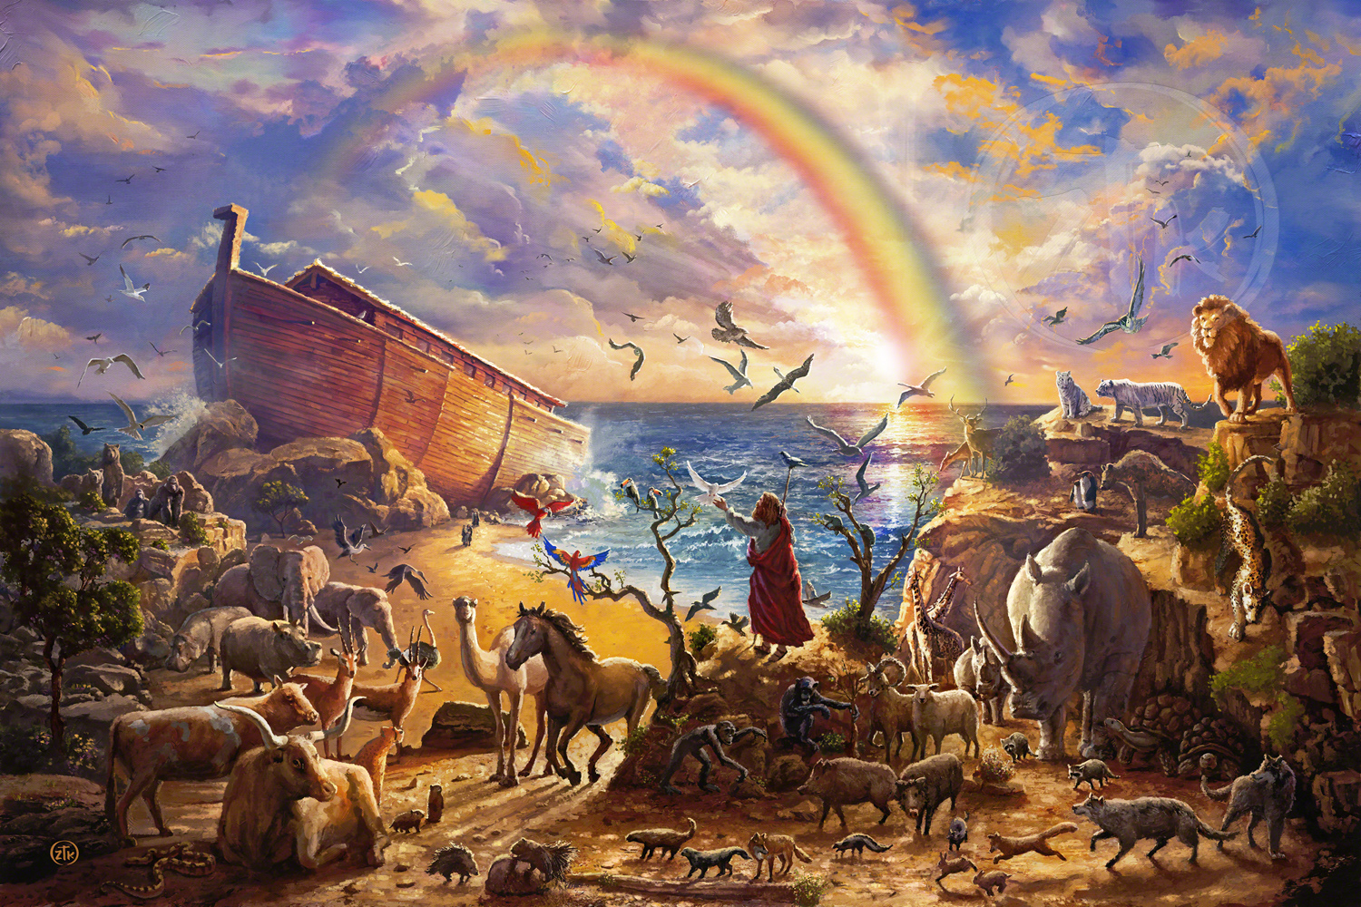
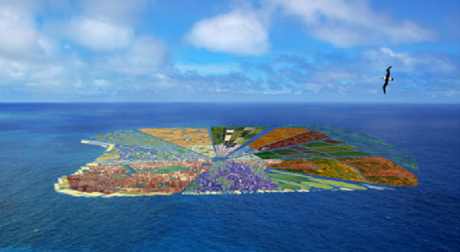
Noah’s
Theong’s
Ark

Slide 12

And That’s Where You Come In

Slide 13
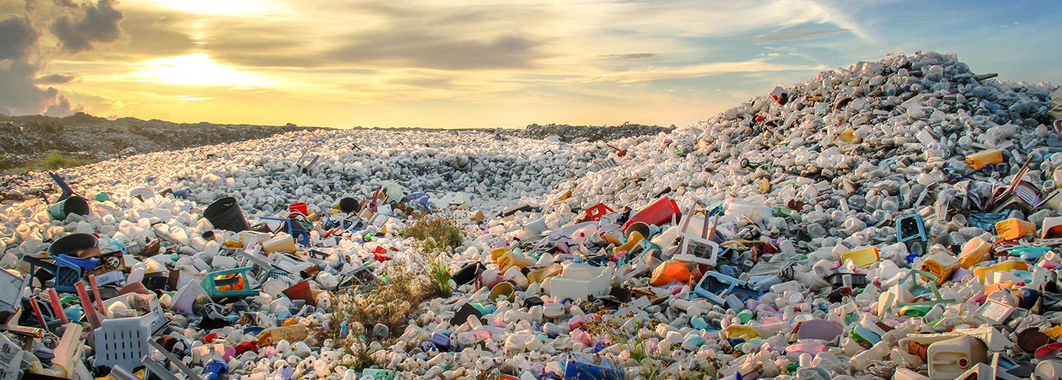
Waste R&D

Slide 14
Today’s Agenda
Intros and Icebreakers
Team Assignments
Data Collection aka “The Hunt”
Moral Boosting
Results Reporting

Slide 15
MOST RECENT SIMULATION RESULTS

Slide 16
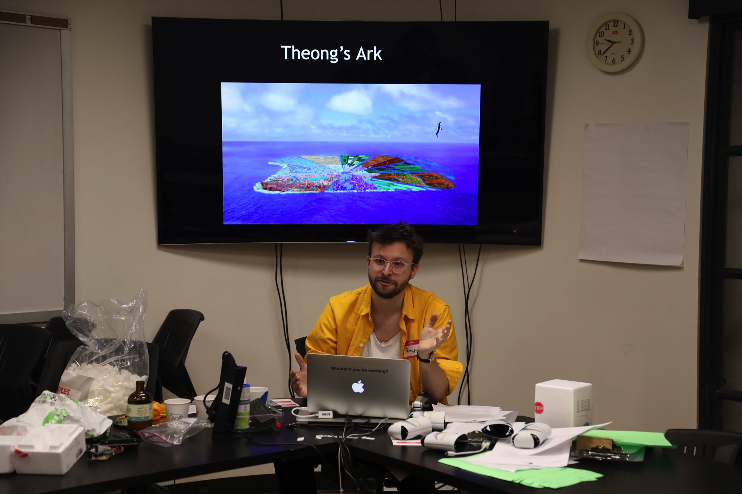

Slide 17
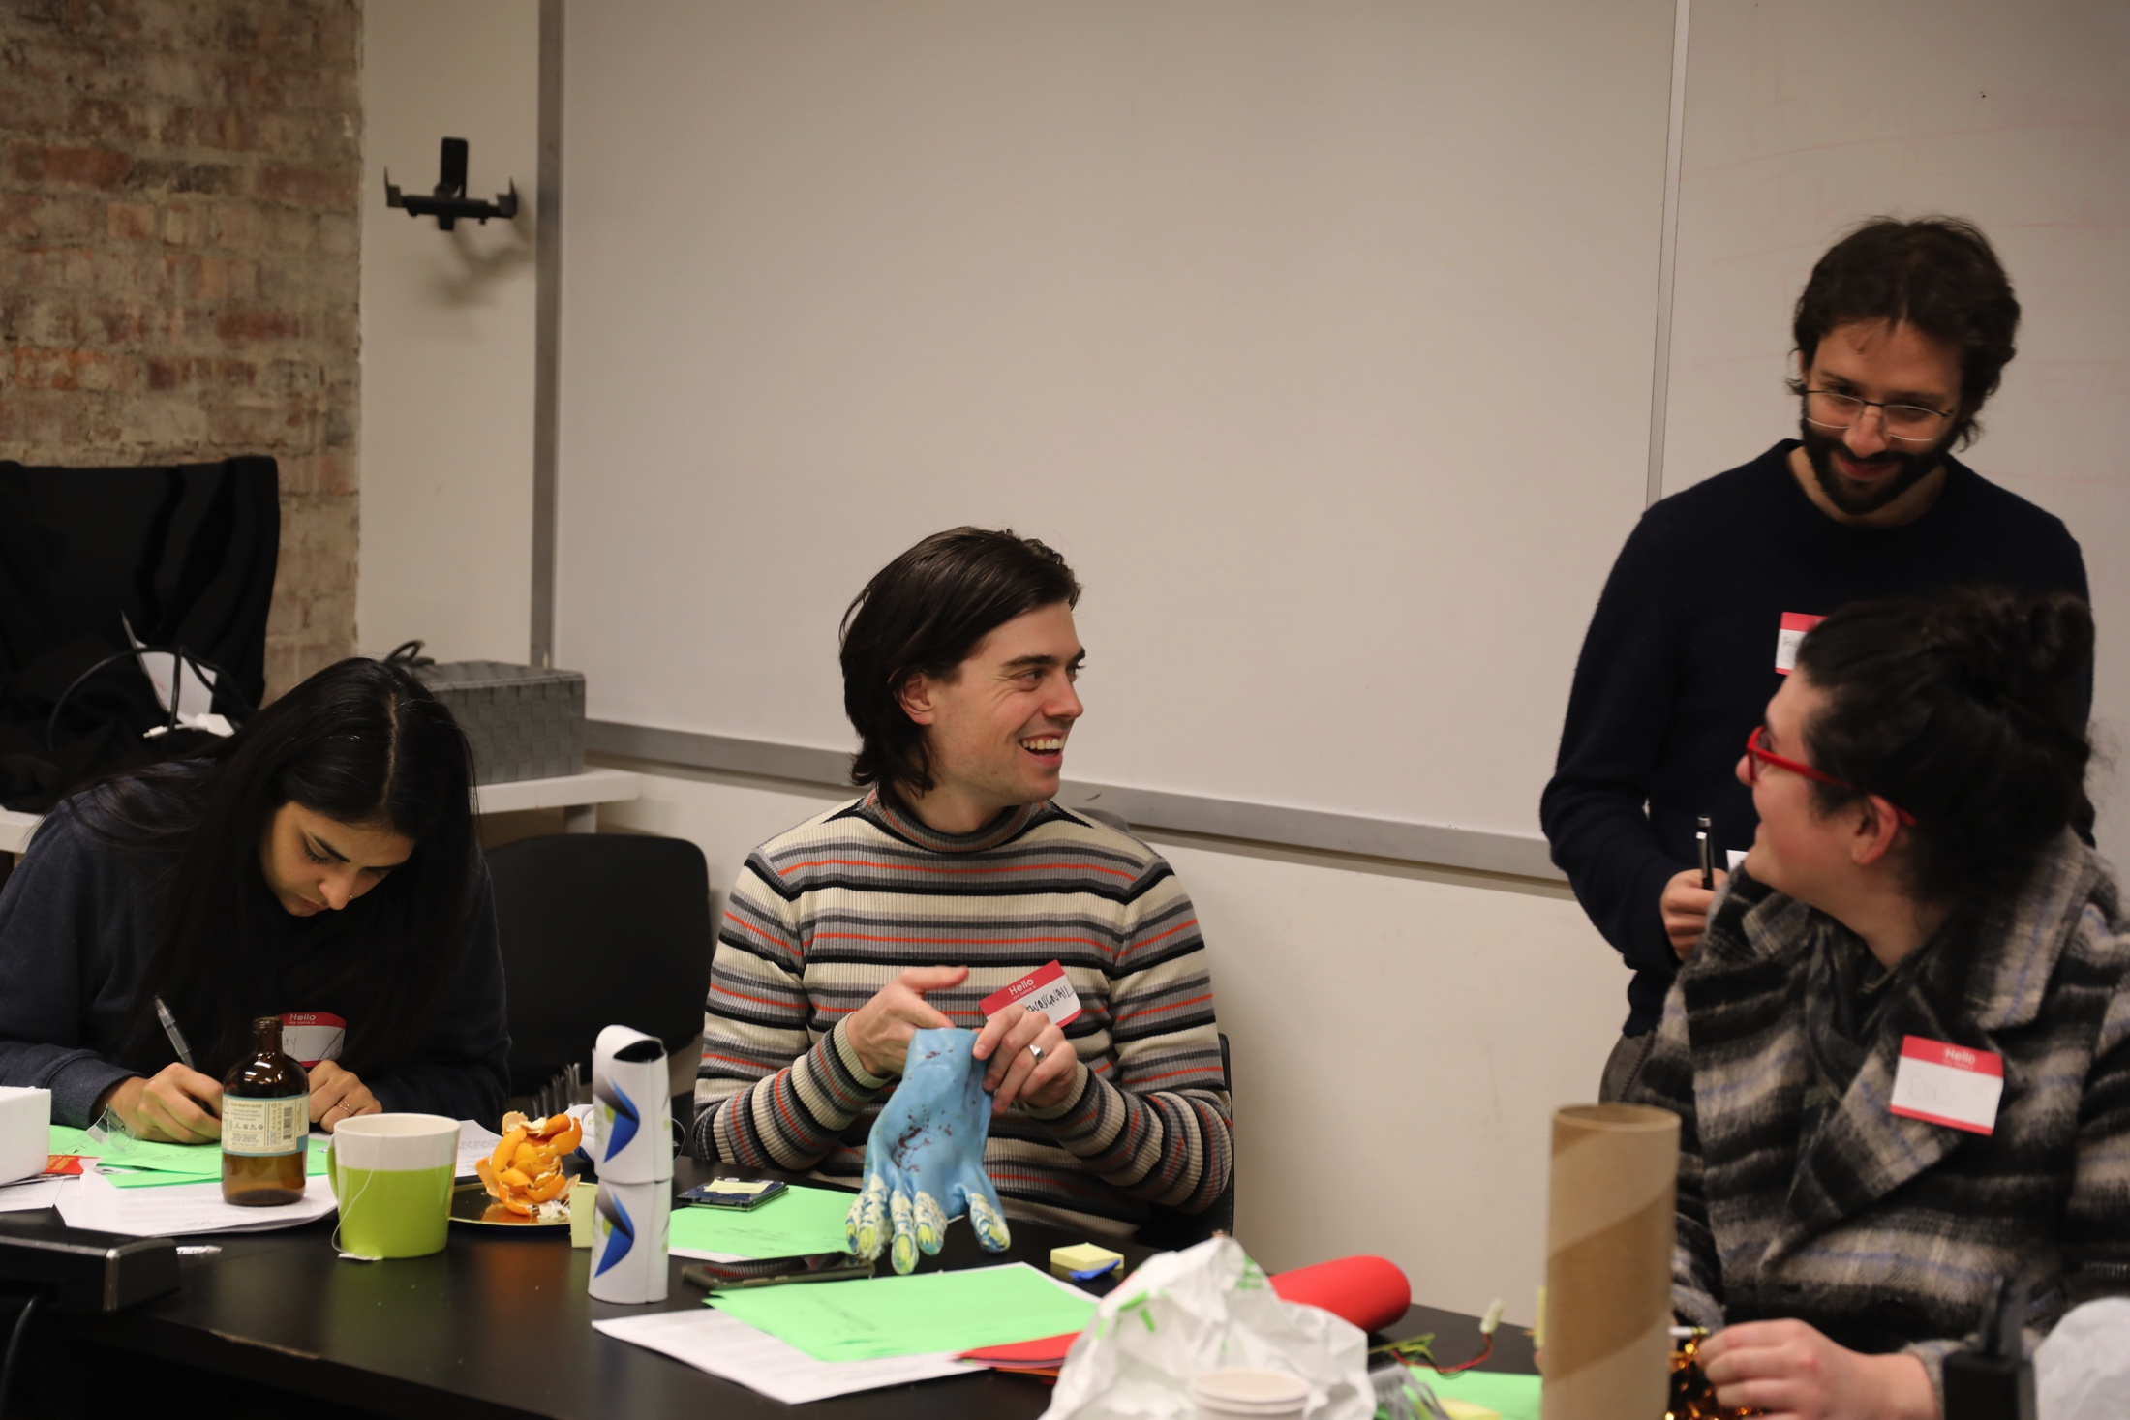

Slide 18
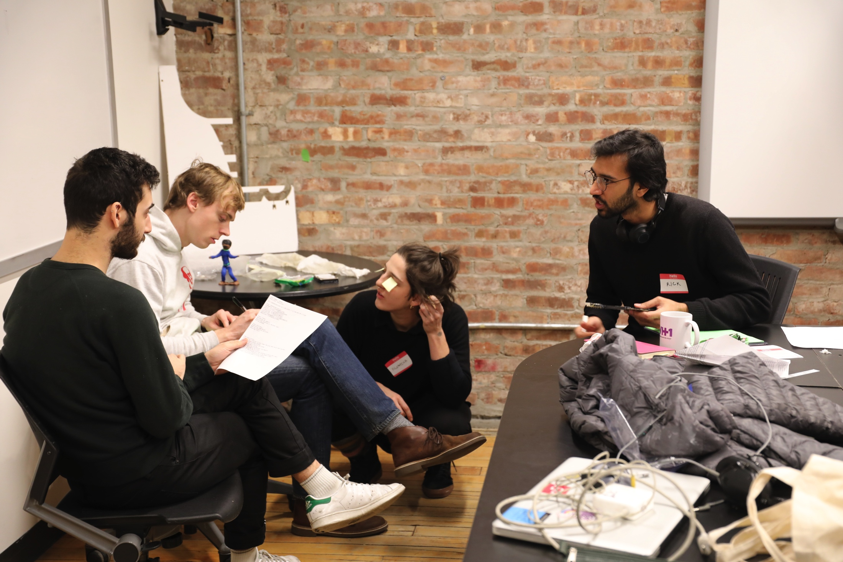

Slide 19
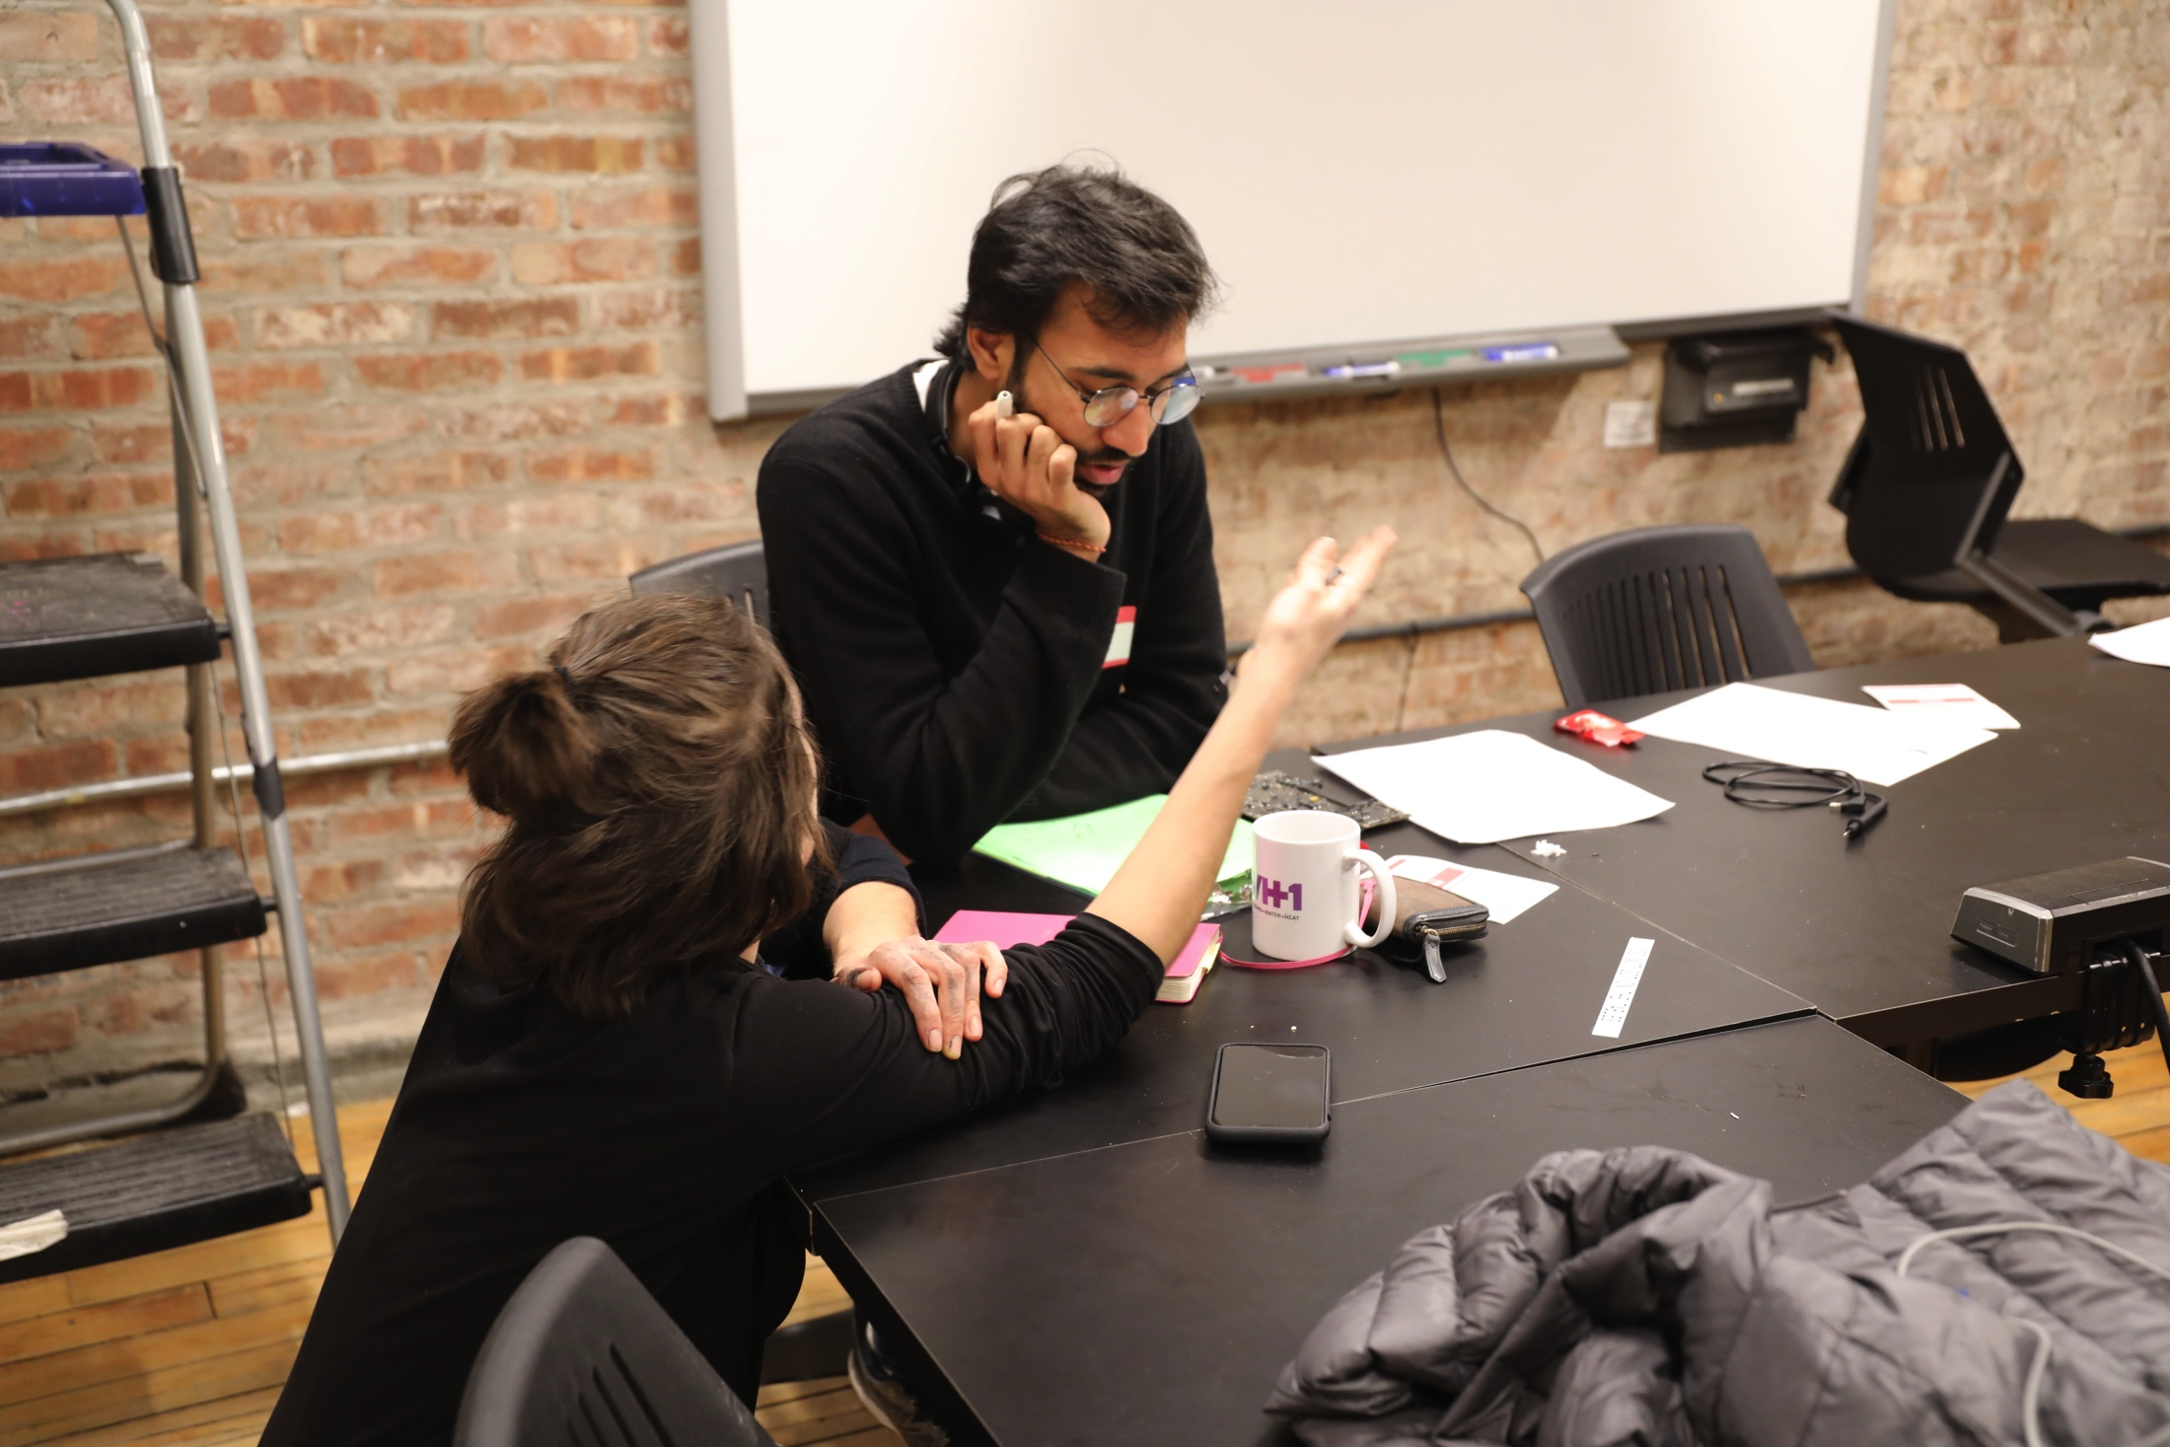

Slide 20
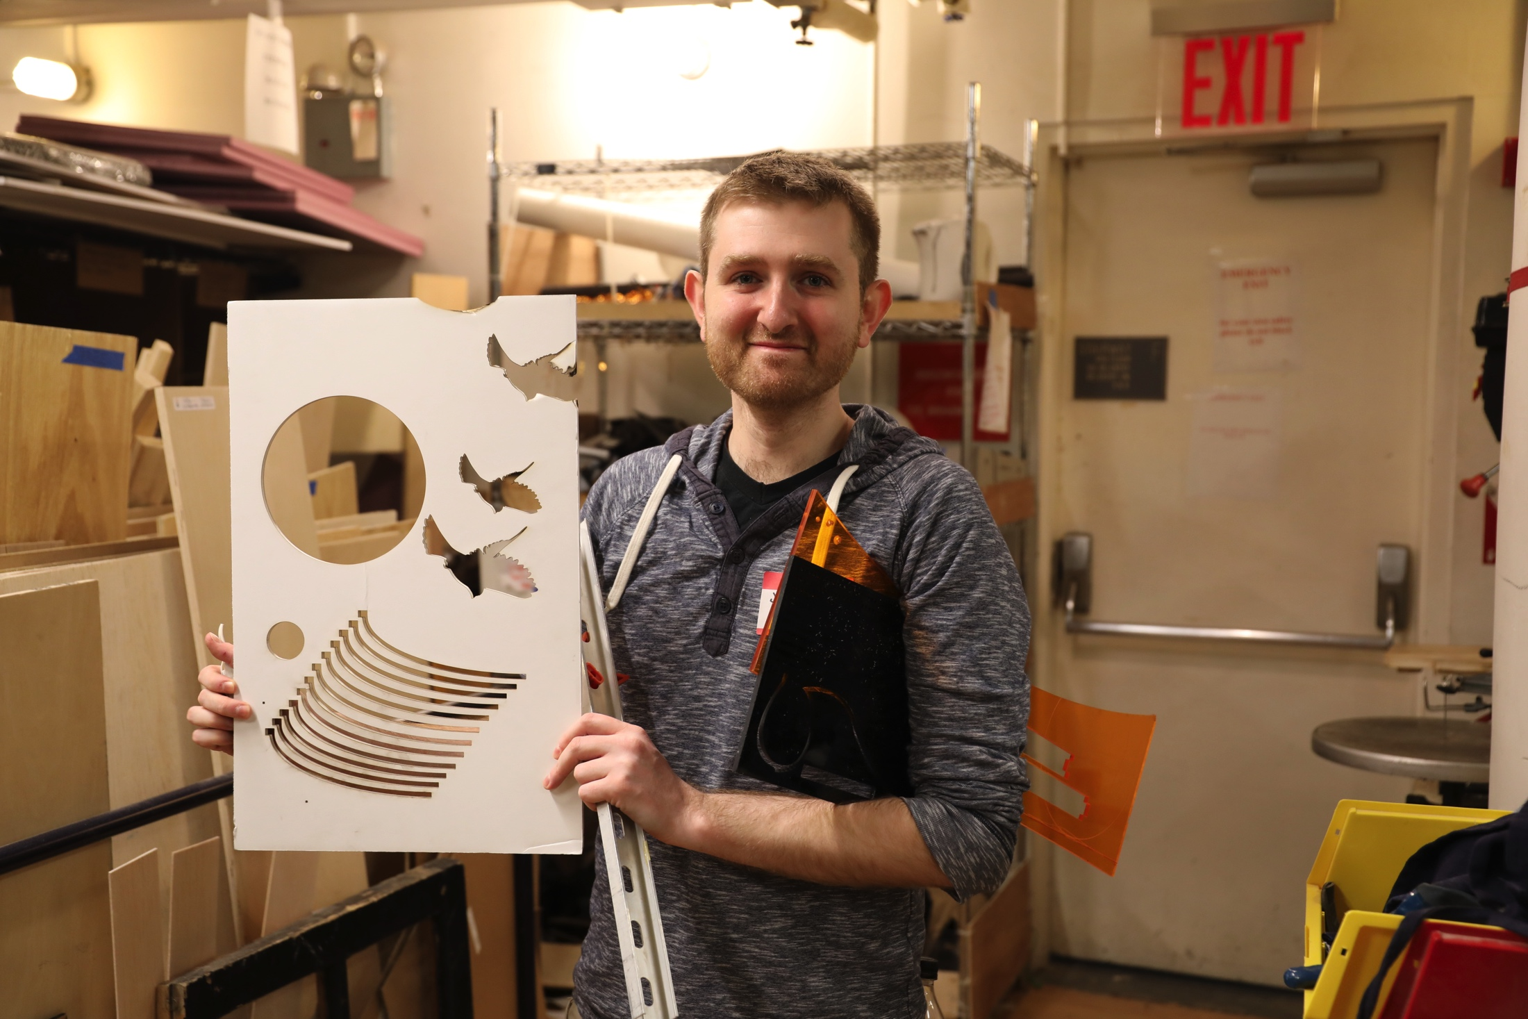

Slide 21
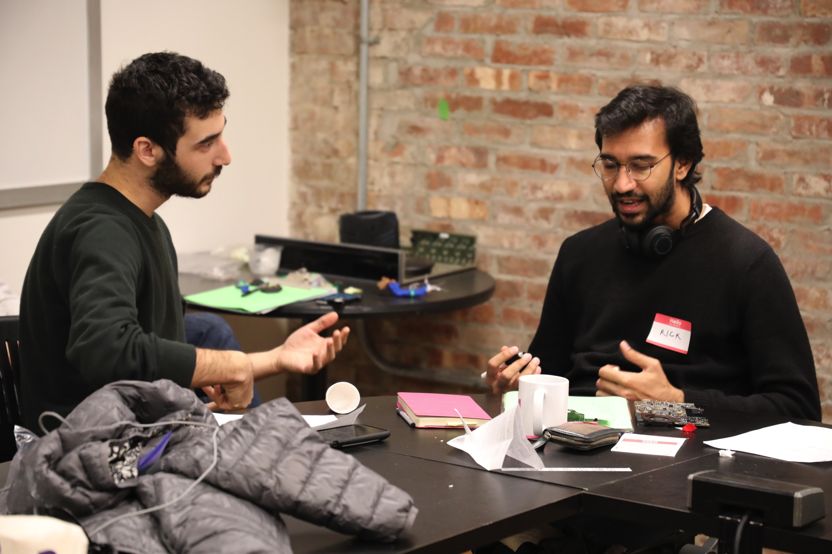

Slide 22
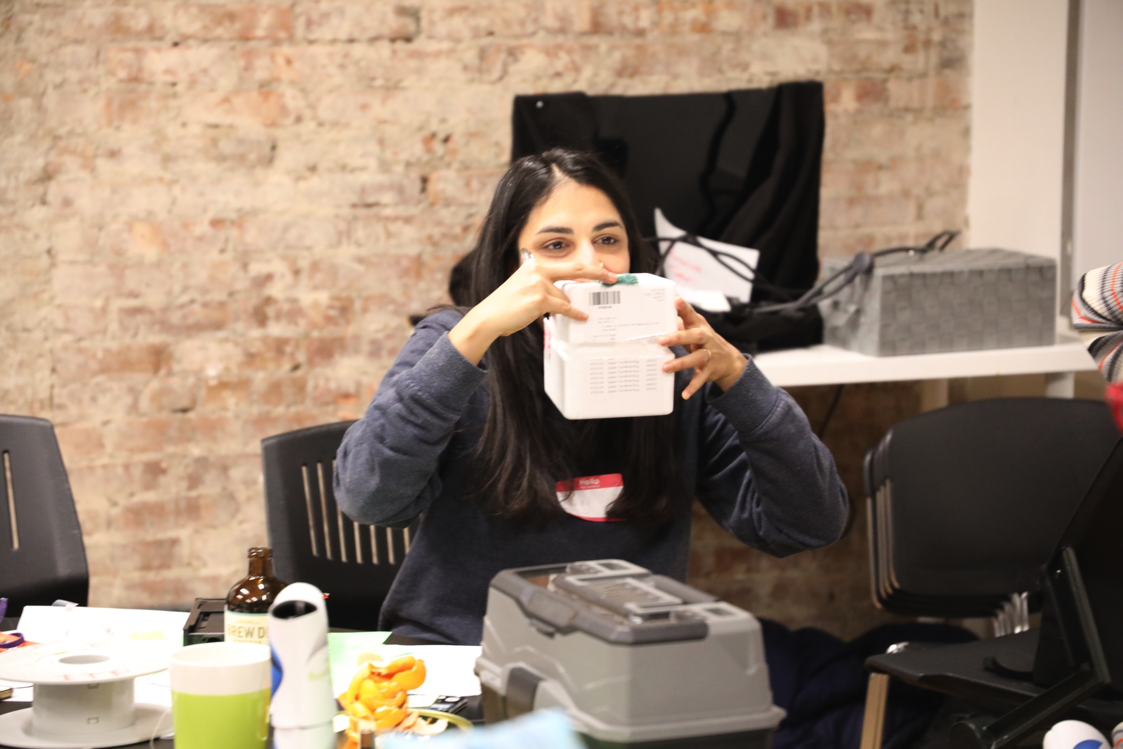

Slide 23
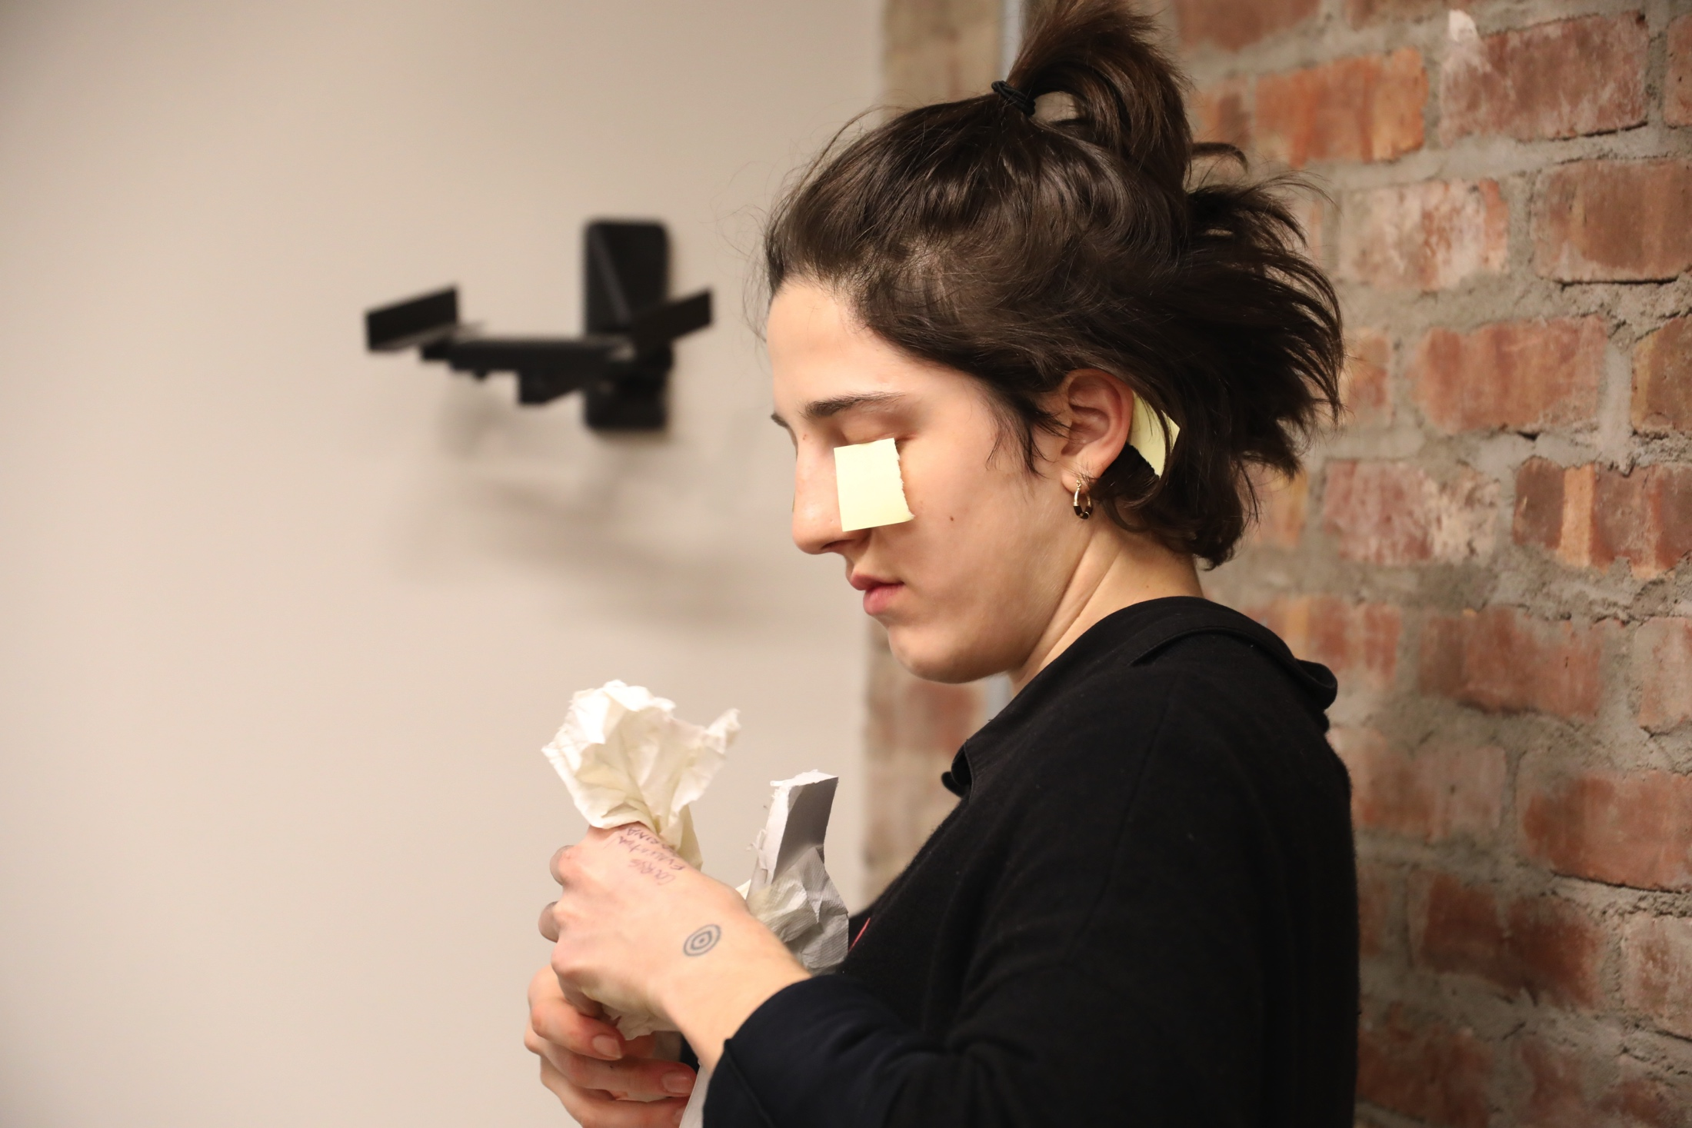

Slide 24
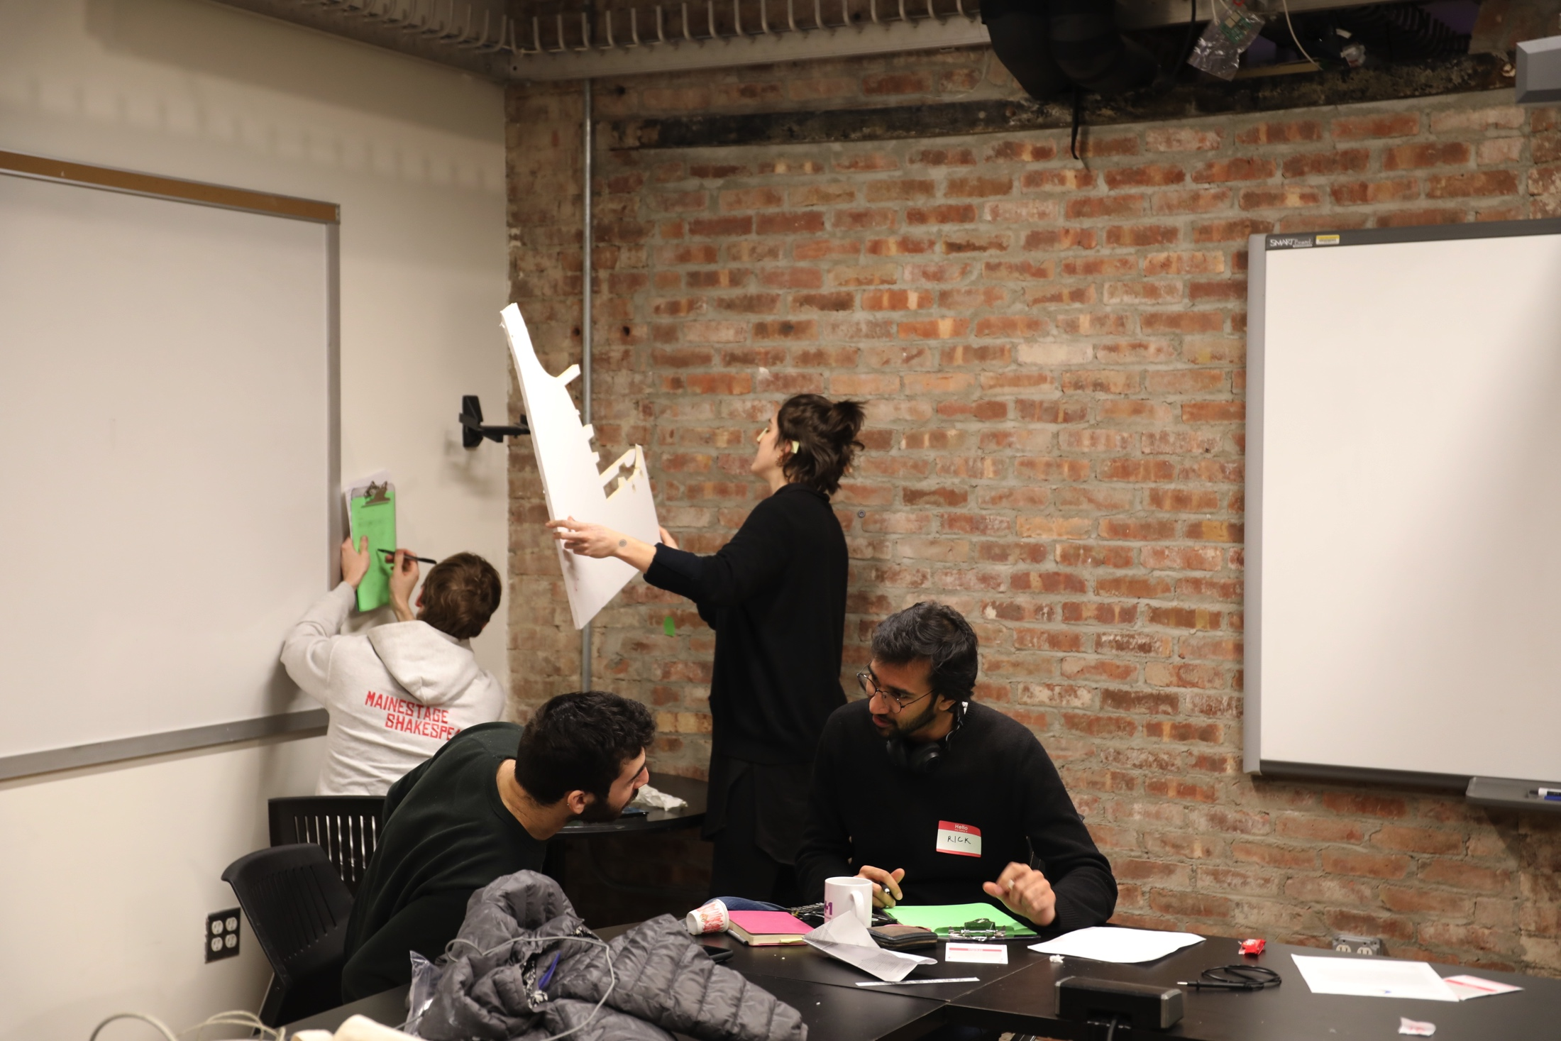

Slide 25
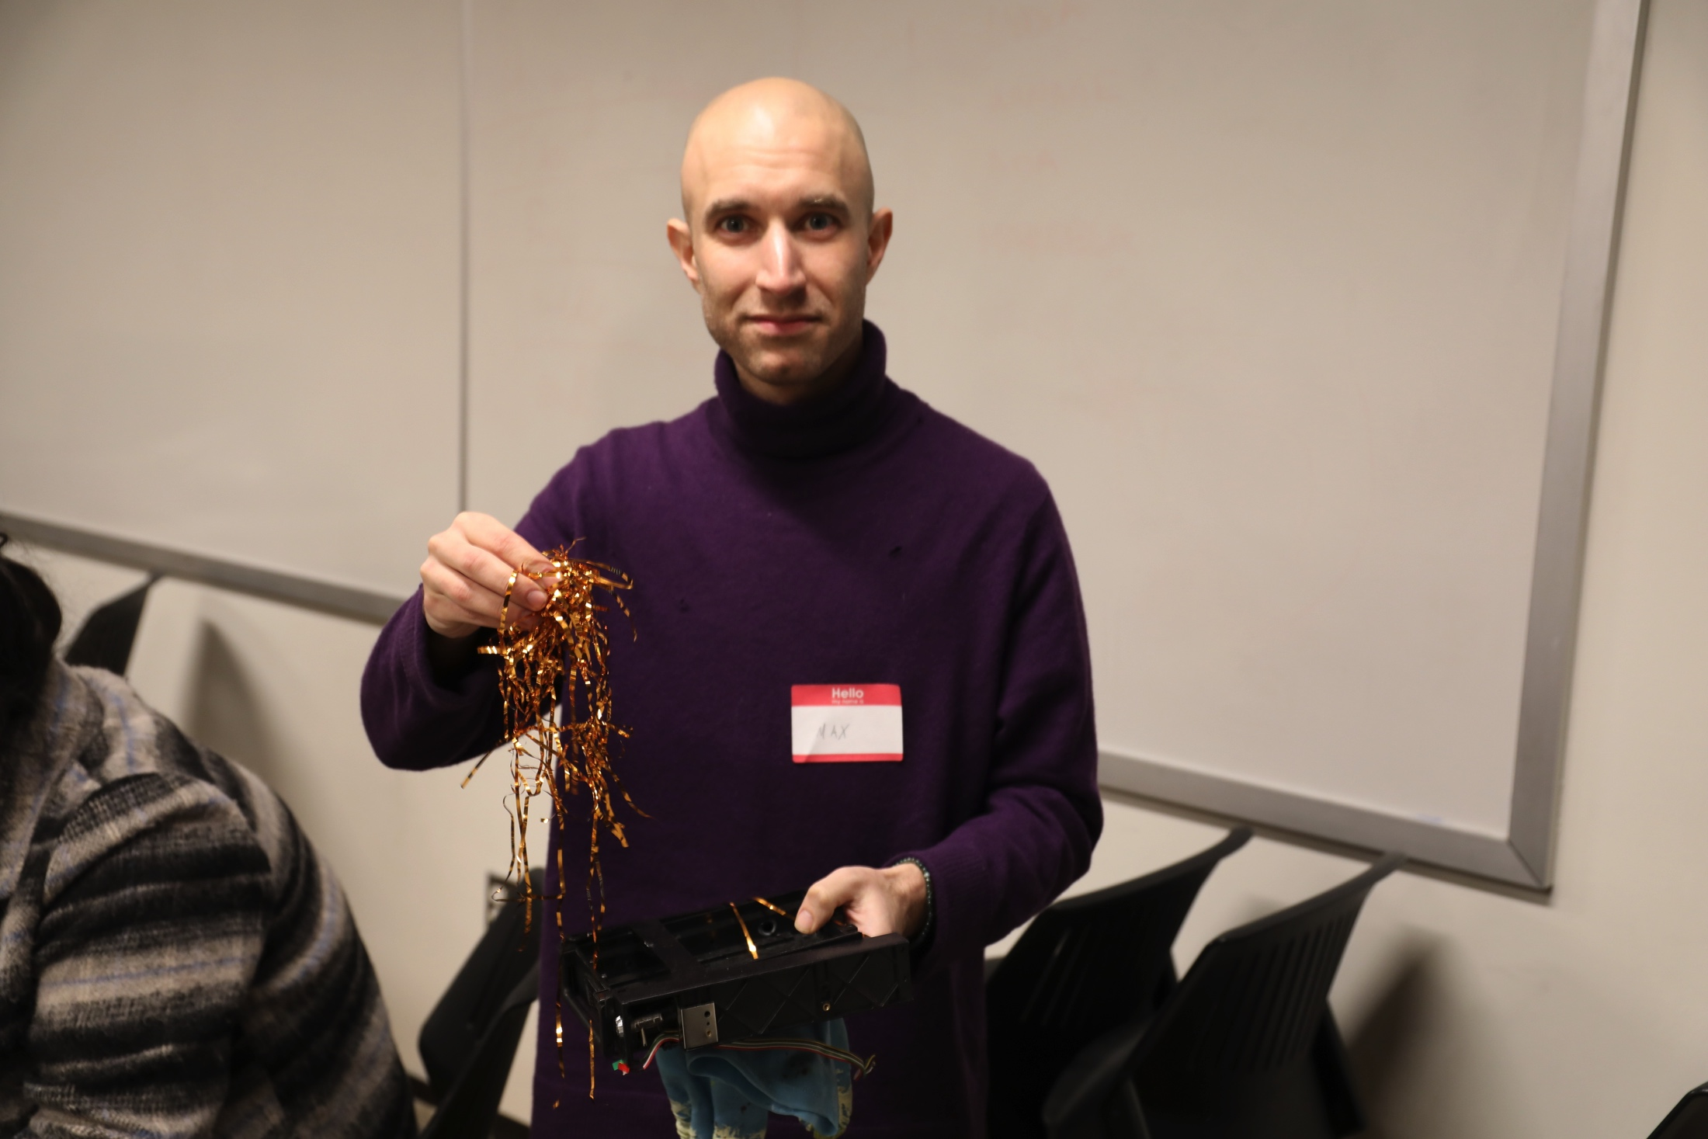

Slide 26
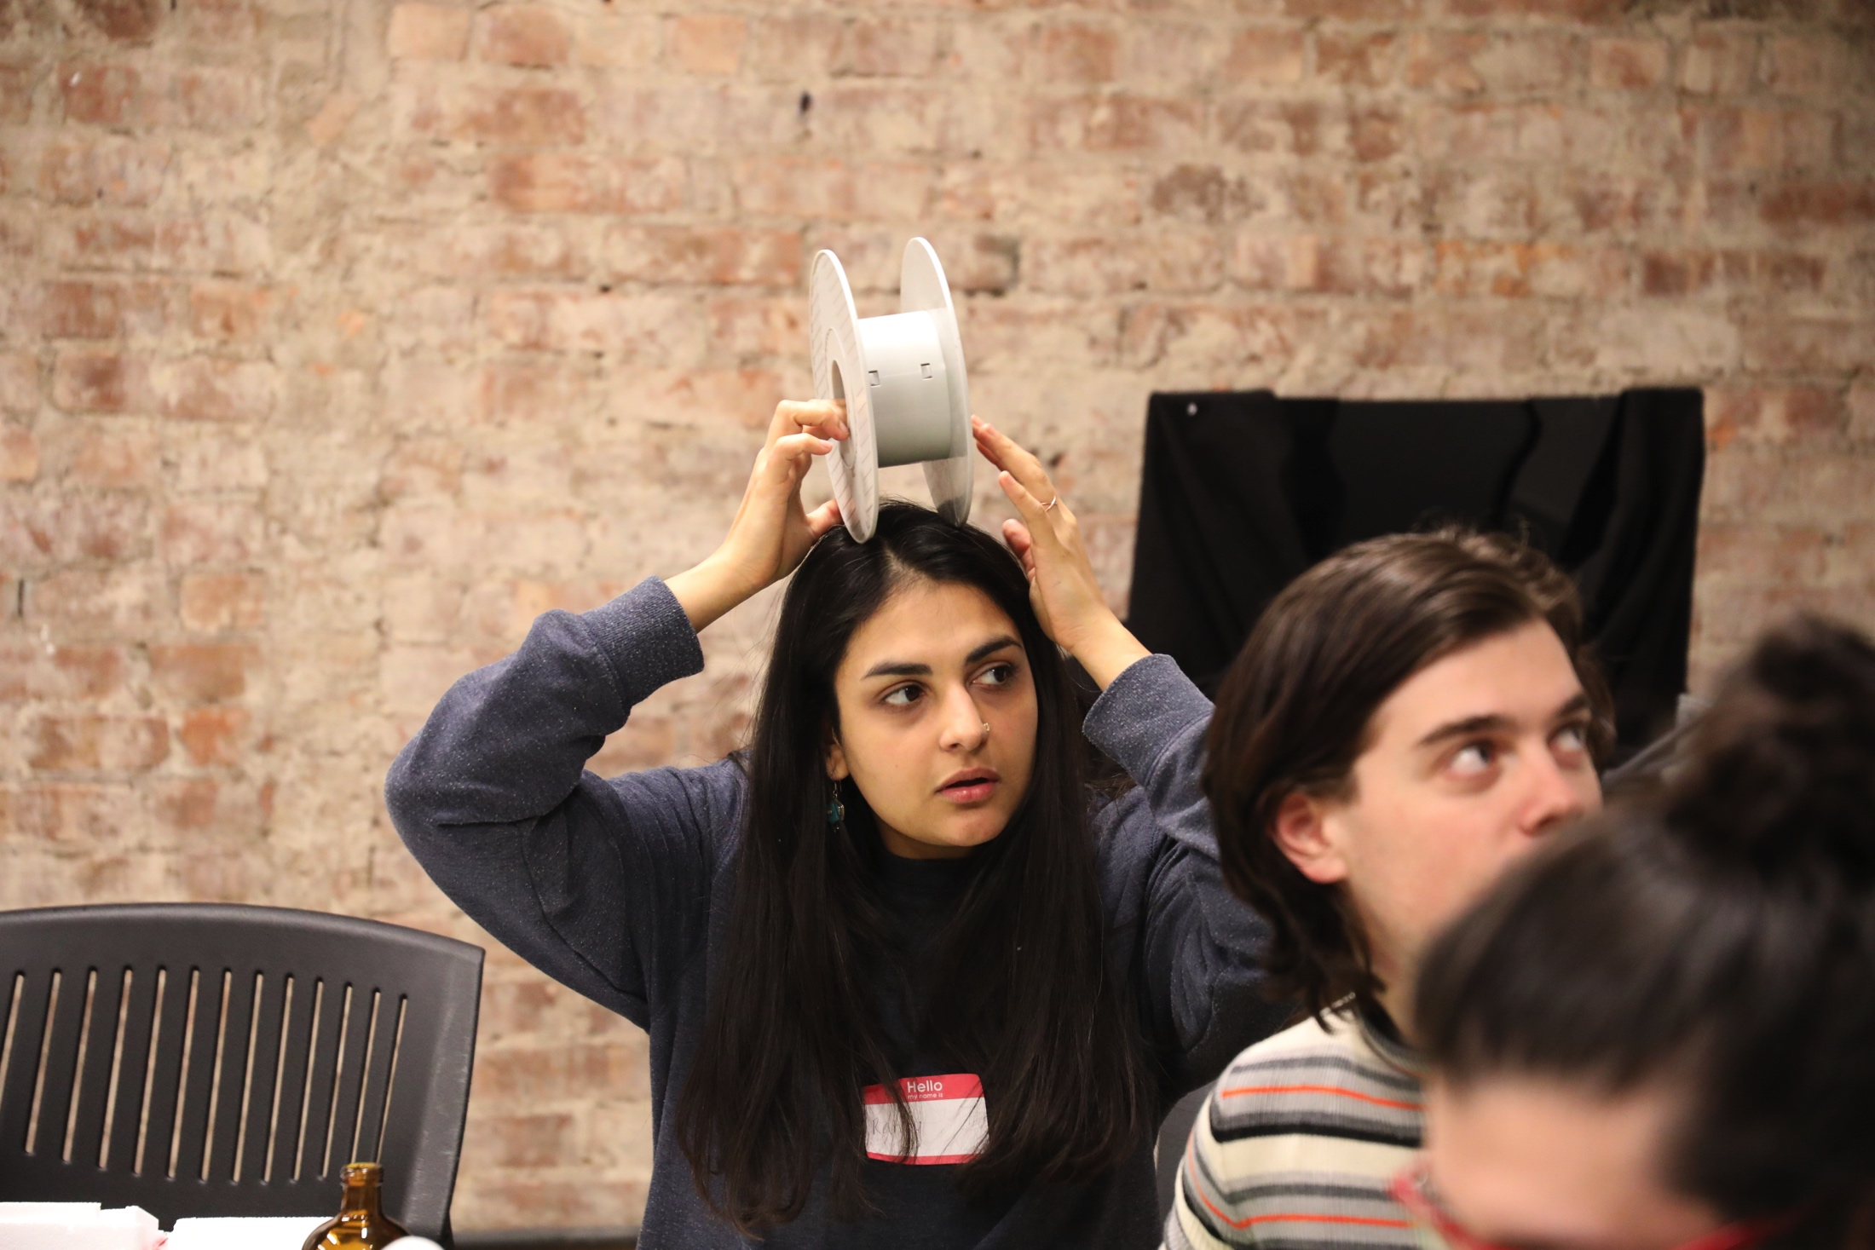

Slide 27
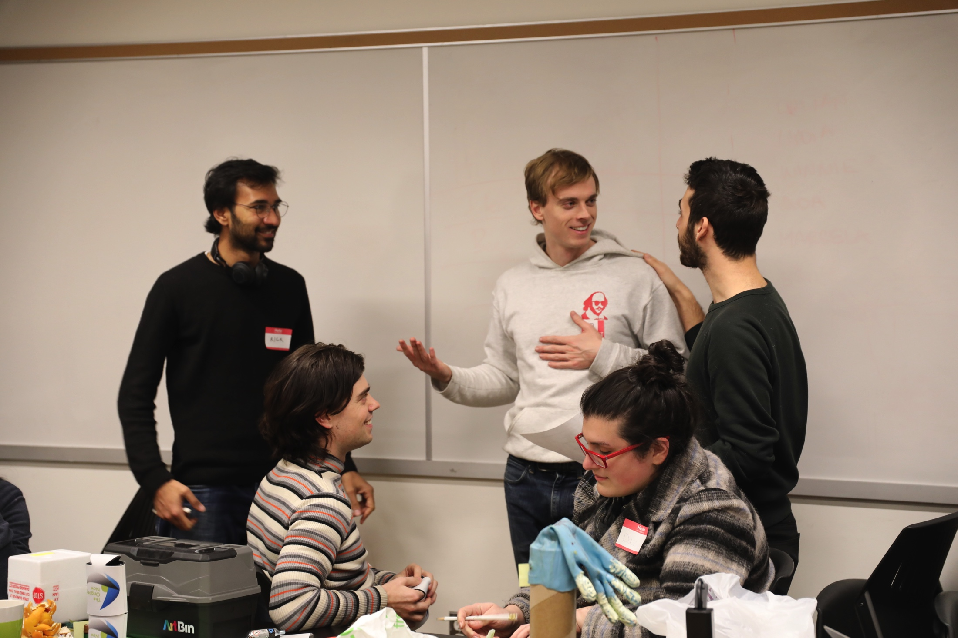

Slide 28
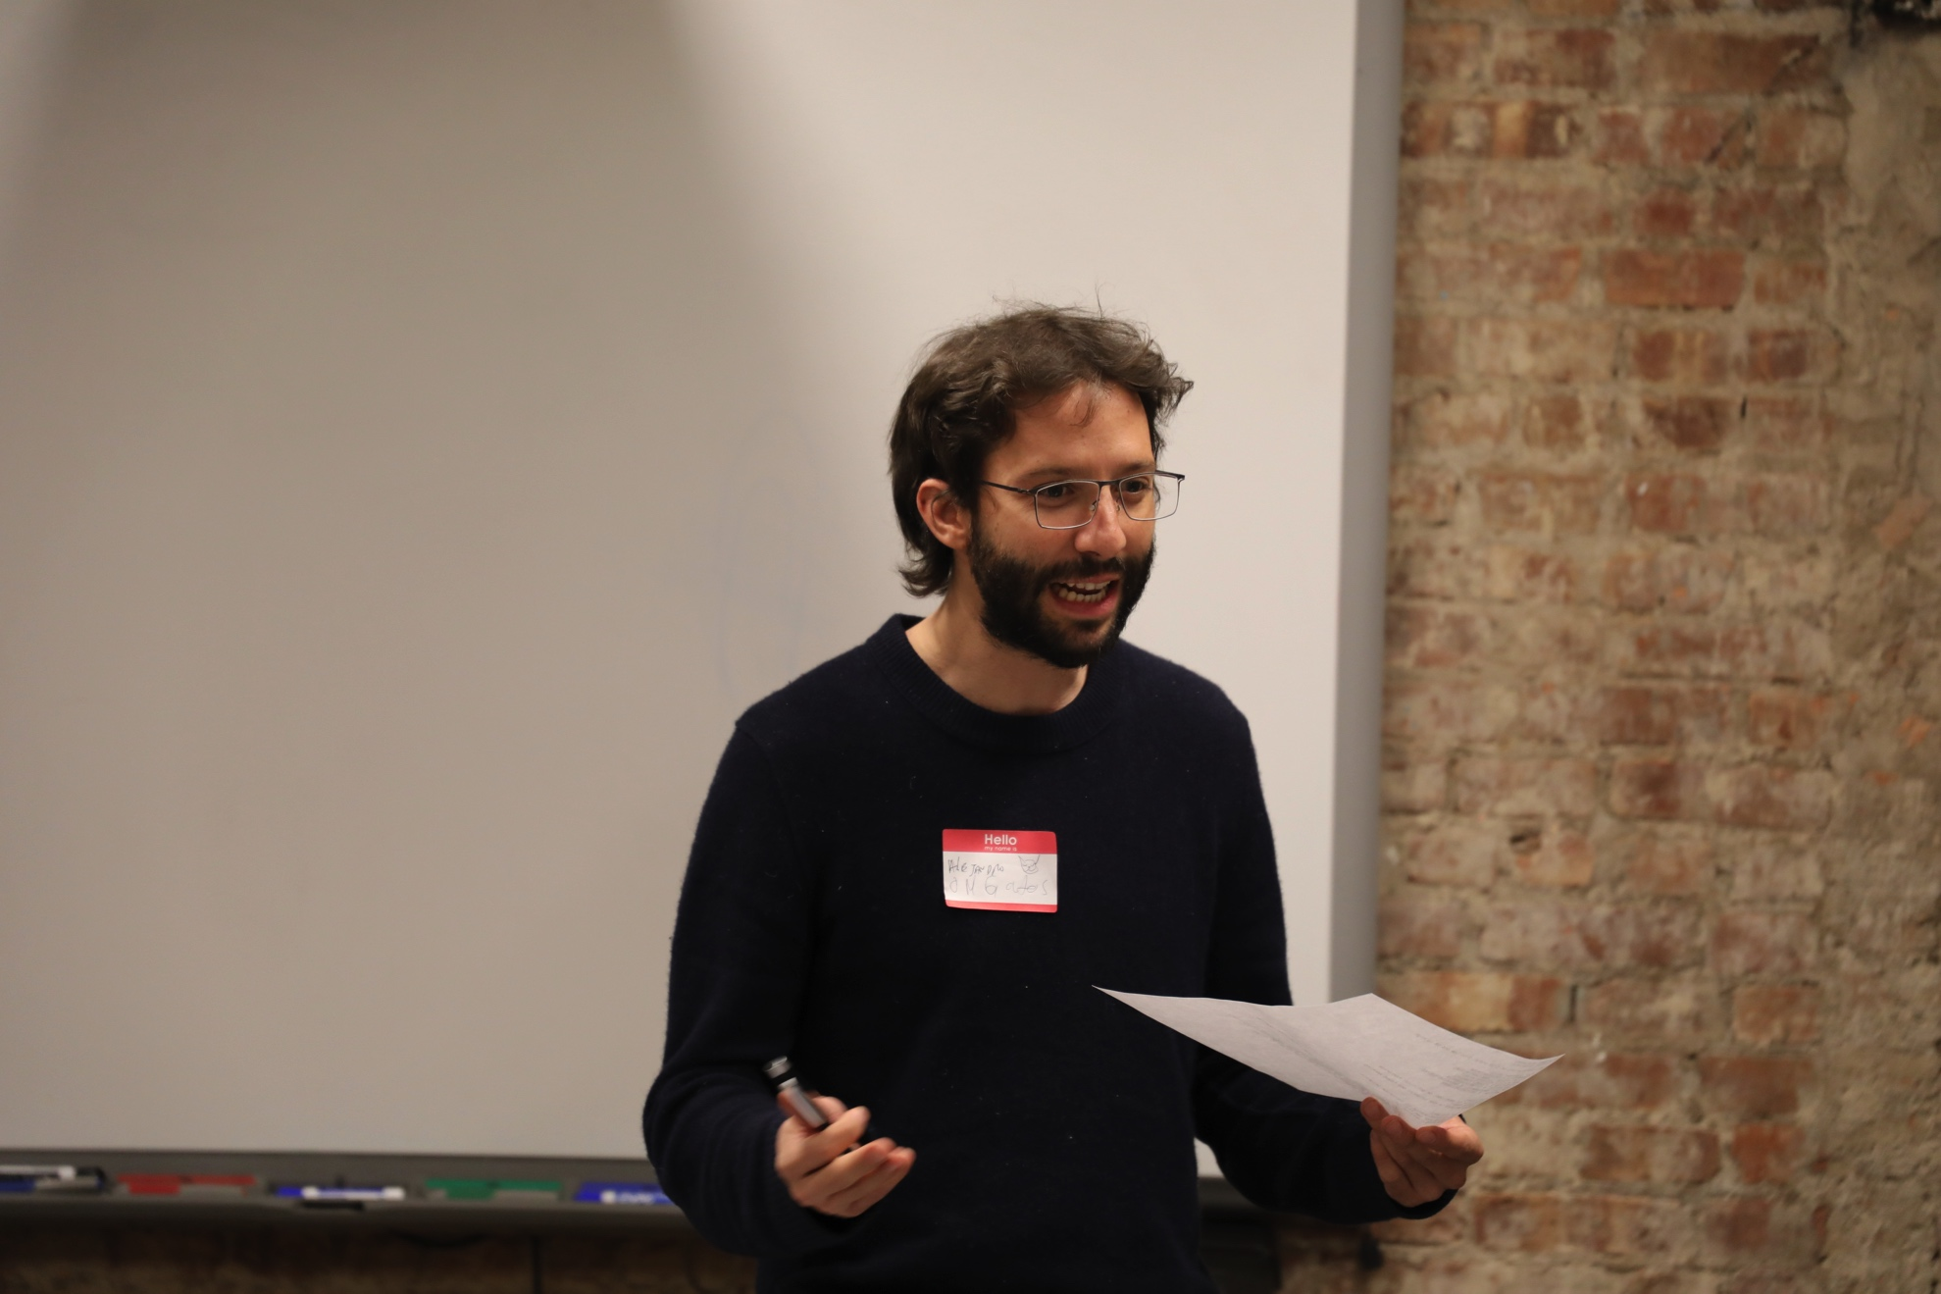

Slide 29
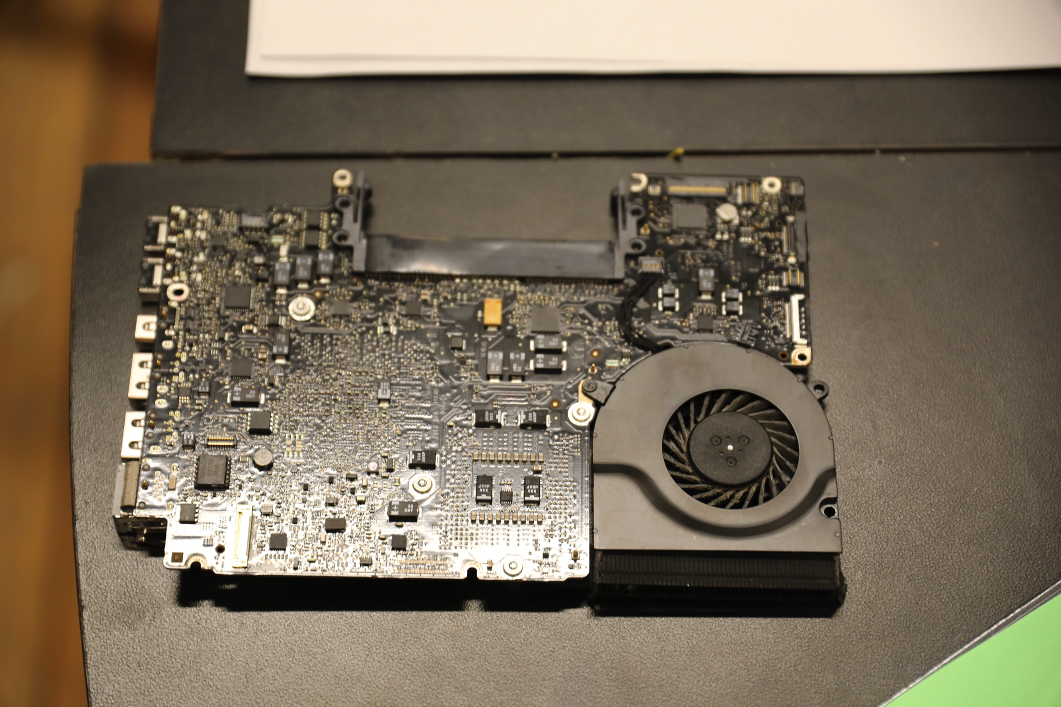

Slide 30
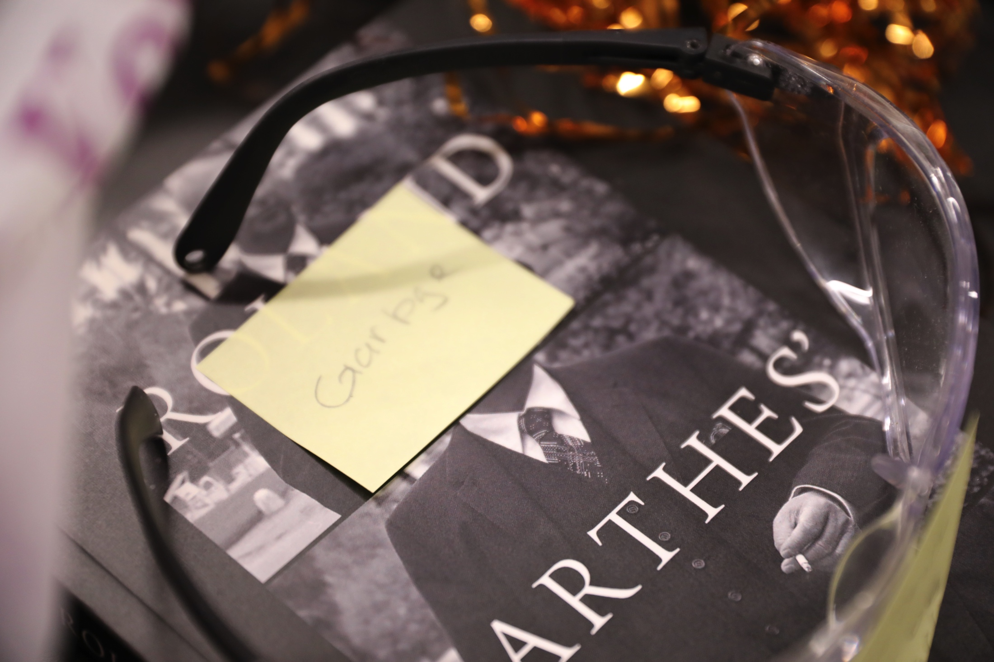

Slide 31
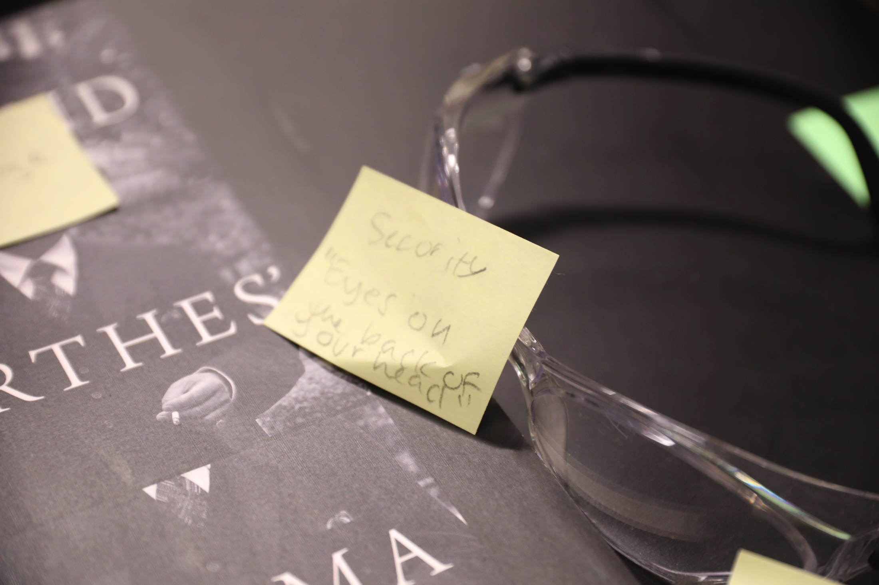

Slide 32
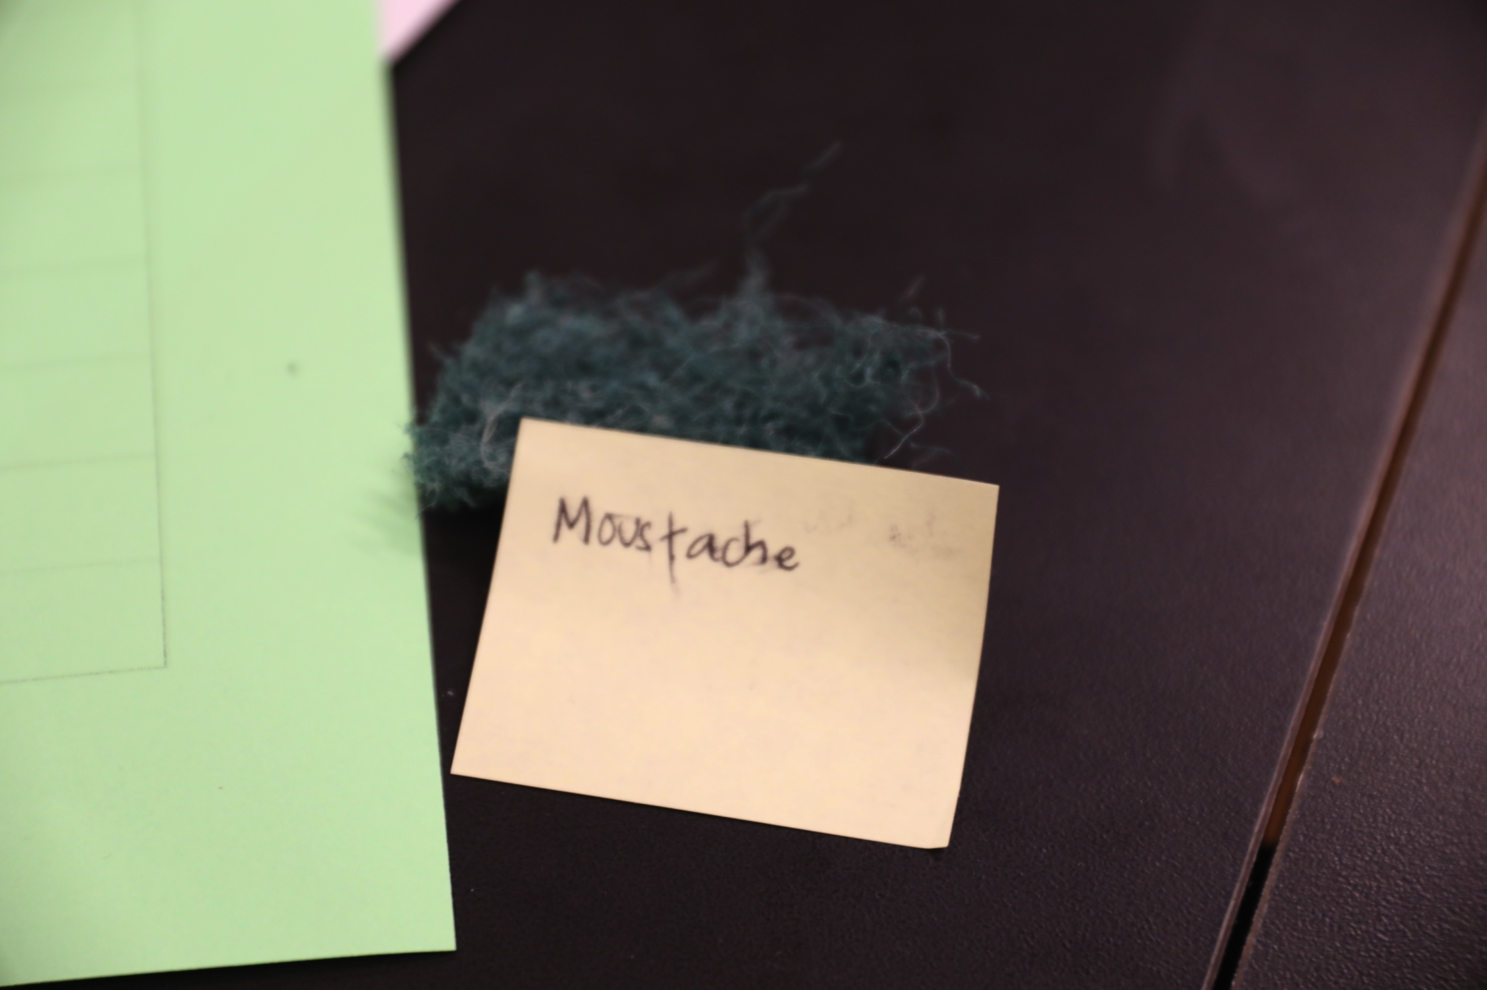

Slide 33
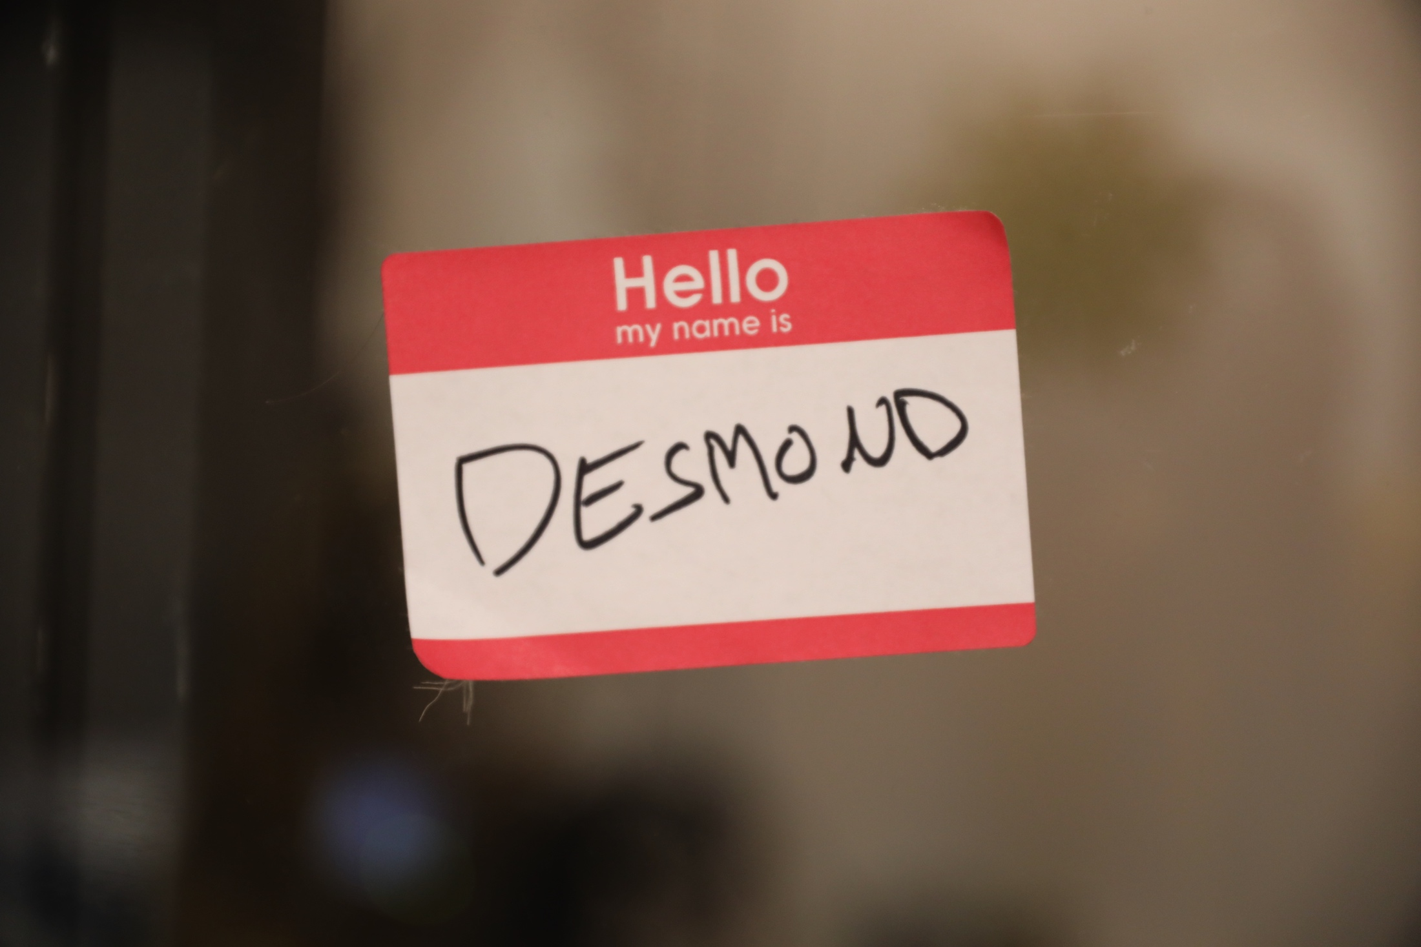

Slide 34
GOALS

Slide 35
Defamiliarize the alienated waste-object and open up new conceptual possibilities for its future

Slide 36
Create new affective relationships with garbage

Slide 37
Overidentify with corporate utopia-builders to play with their messaging

Slide 38
Work with a group to imagine a utopic future even if it’s a terrible one

Slide 39
Explore formal elements of garbage, group simulation, and corporate aesthetics

Slide 40
Have a lot of fun! ☺

Slide 41
Audiences / Contexts
Here at ITP
Conference Workshops
In Gallery Spaces
Corporate Trainings / Team Building Retreats

Slide 42
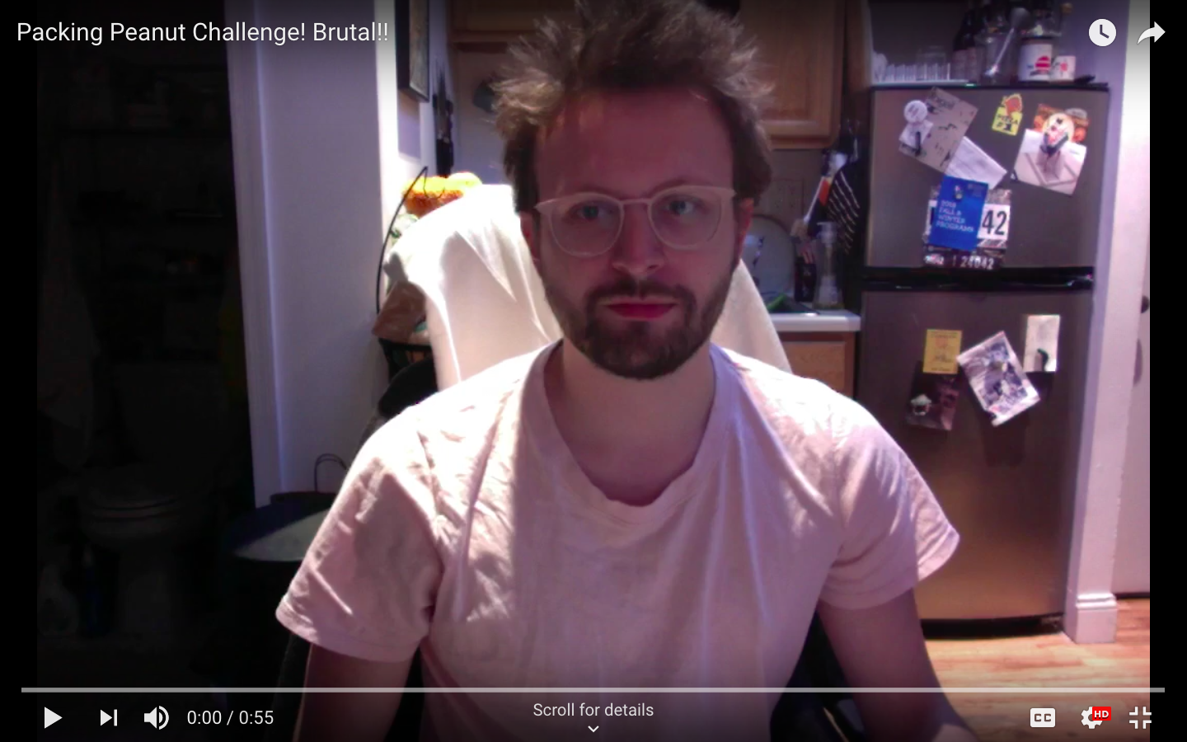

Slide 43
The End
(for now)

